Slide 1
Moral Conviction x Social Consensus Study 3 Initial Report
Sean Duan

Slide 2
Survey Structure

Slide 3
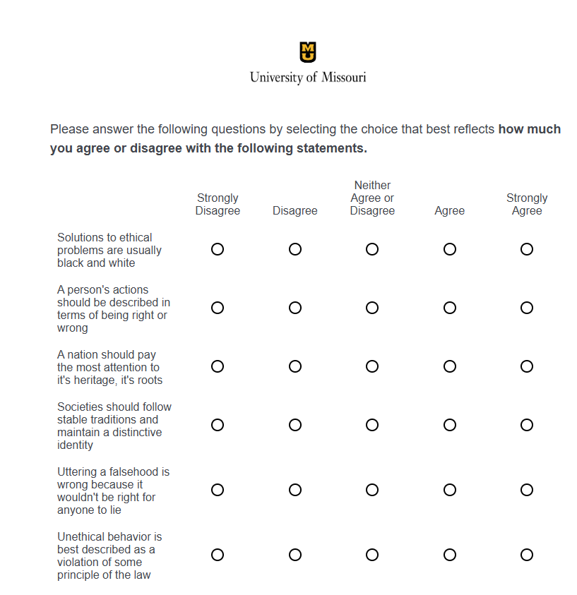
Ethical Standards of Judgement Questionnaire (ESJQ)
Utilitarian Subscale
Deontological Subscale

Slide 4
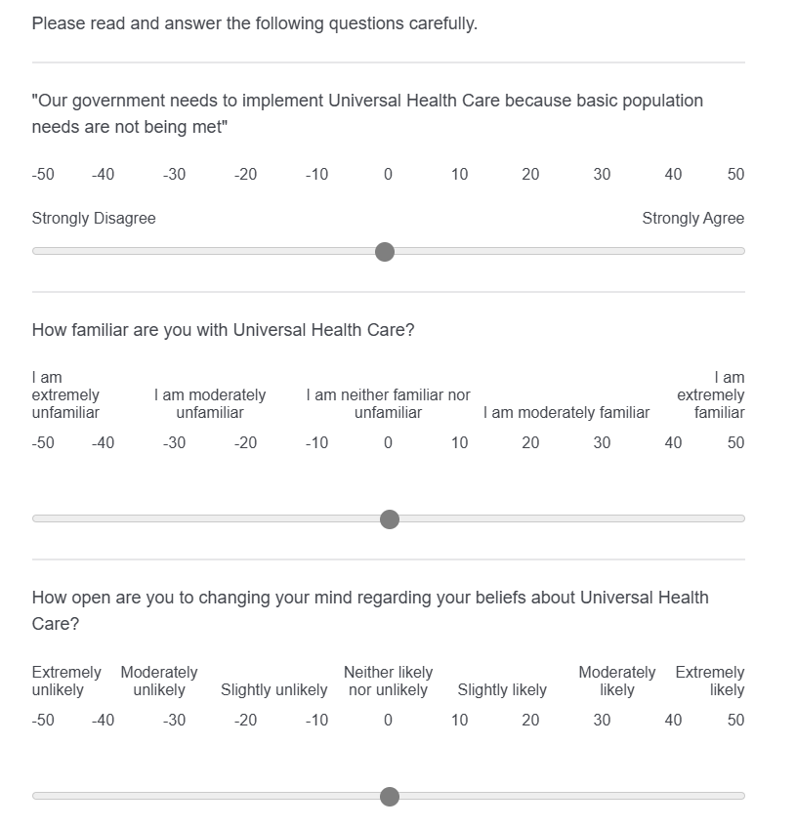
Initial Measures of [Topic]

Slide 5
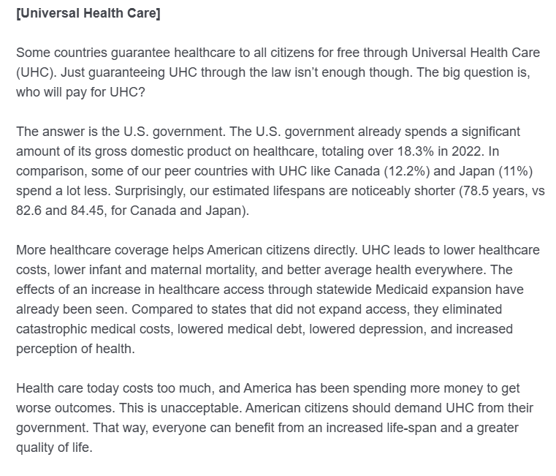
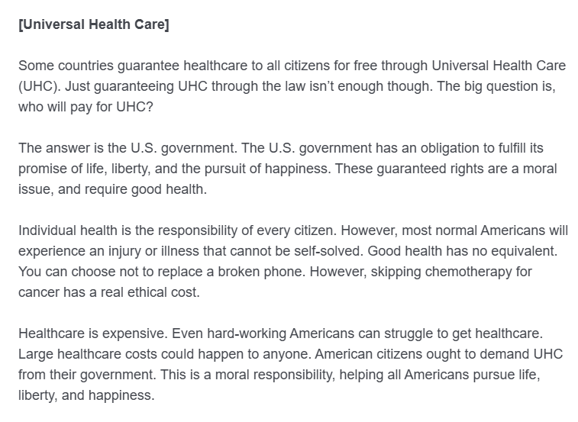
Moral Conviction Manipulation
Low Moral Conviction (Practical/Pragmatic)
High Moral Conviction (Moral Responsibility)

Slide 6
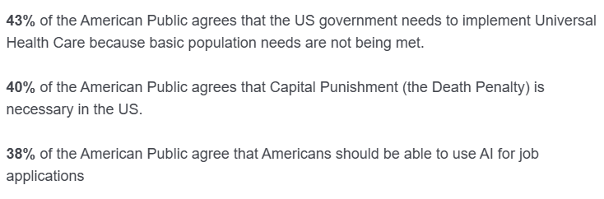
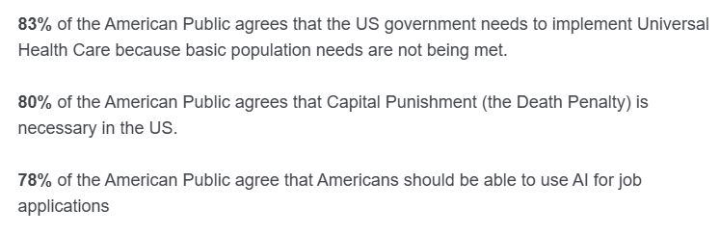
Social Consensus Manipulation
Low Social Consensus
High Social Consensus

Slide 7
Final Measures of [Topic]

Slide 8
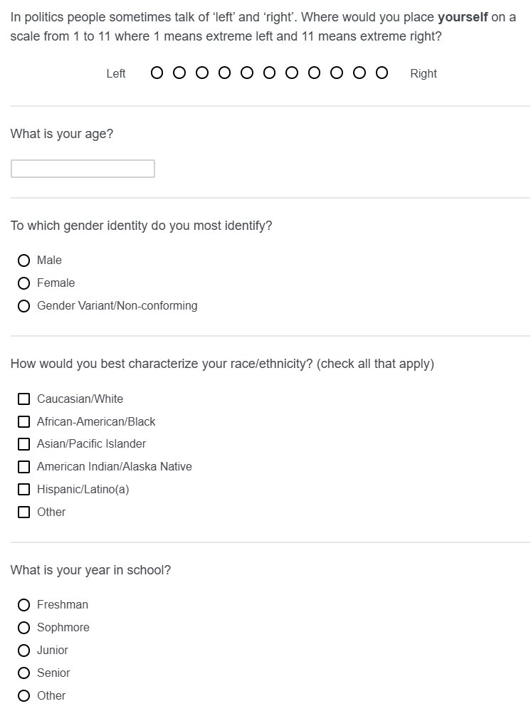
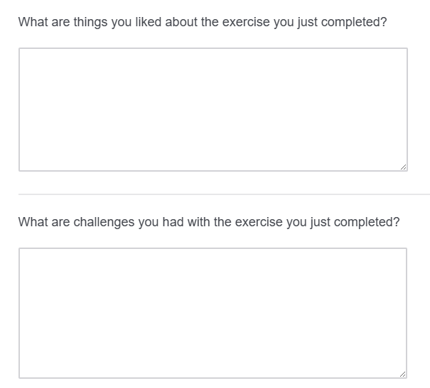
Free Response and Demographics

Slide 9
Exploratory Analyses
Baseline Differences in Initial Measures

Slide 10
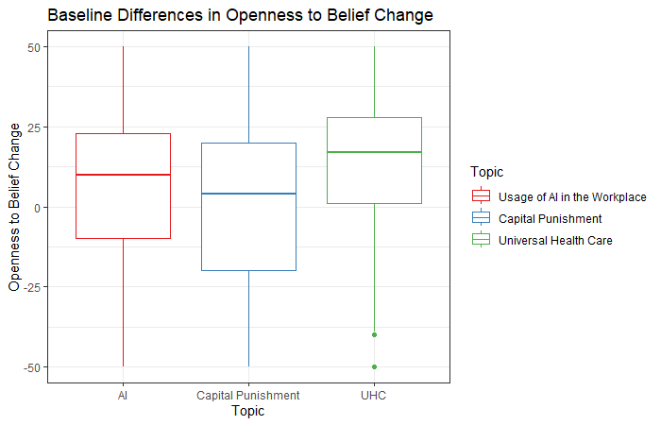

Slide 11
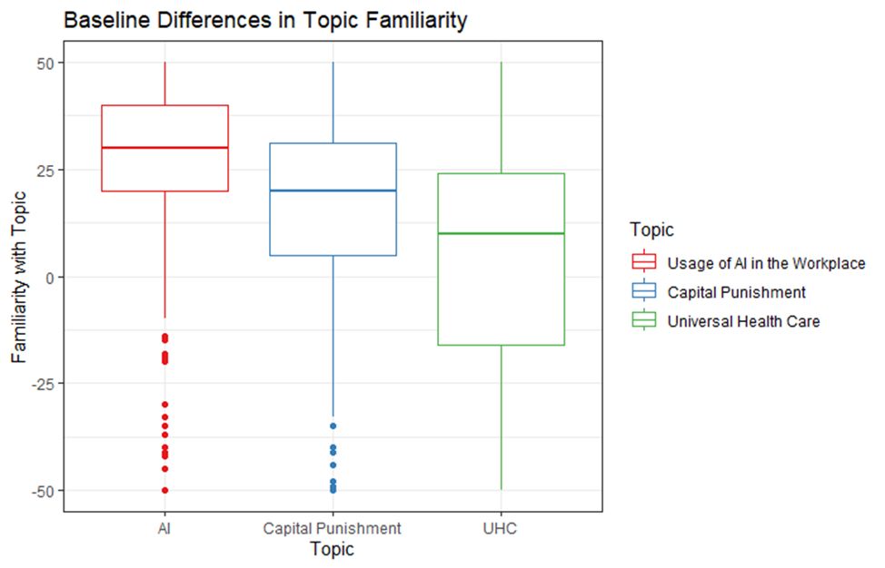

Slide 12
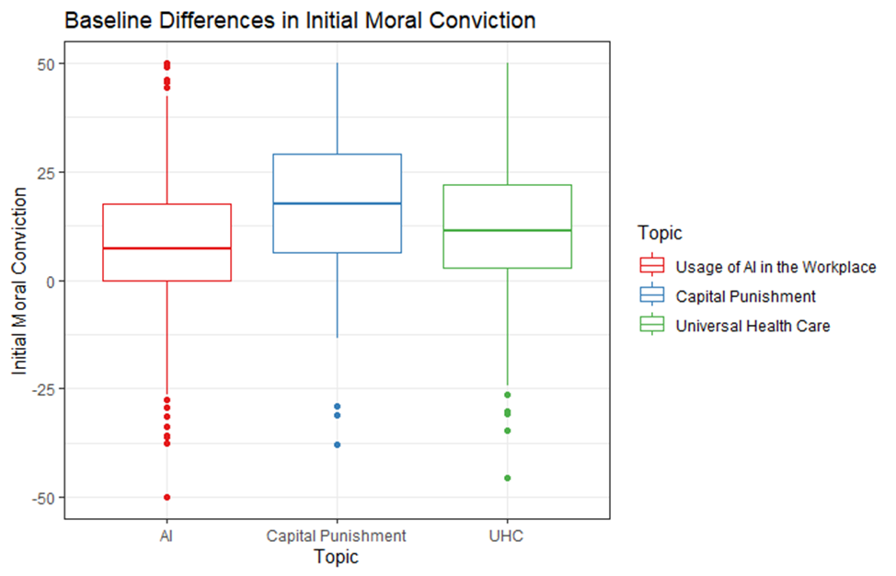

Slide 13
Universal Health Care (UHC)
"Our government needs to implement Universal Health Care because basic population needs are not being met"

Slide 14
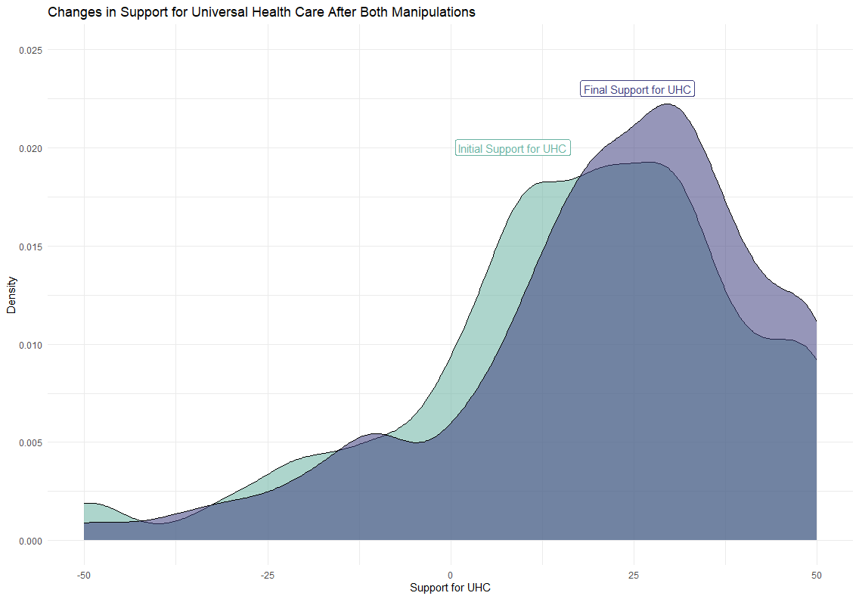

Slide 15
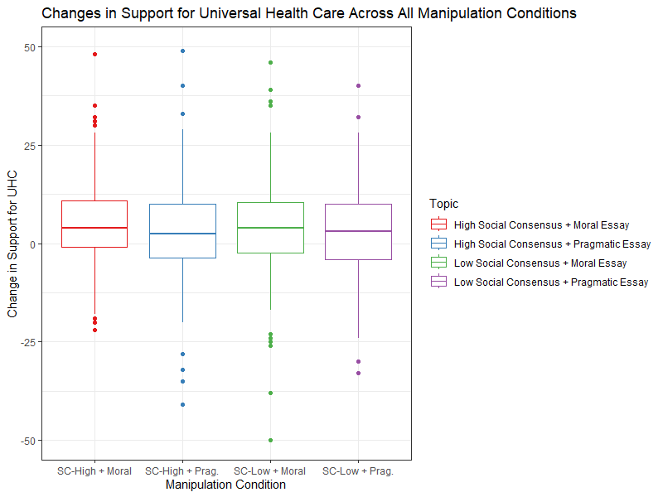

Slide 16
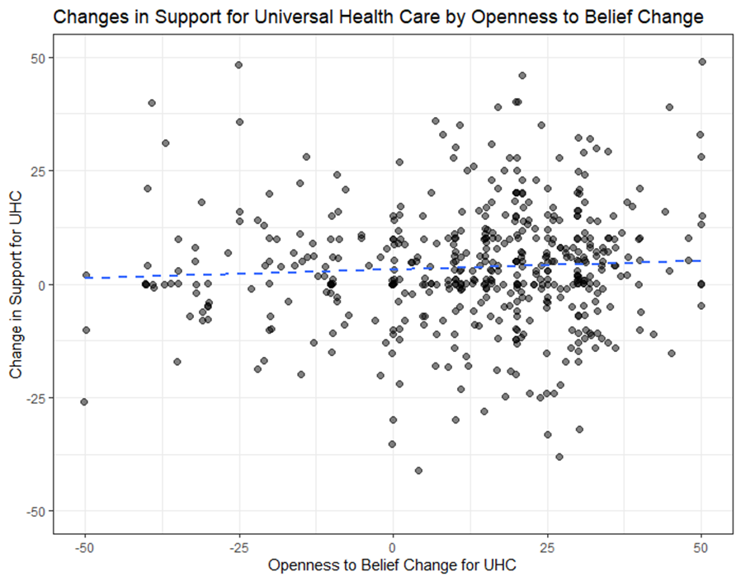

Slide 17
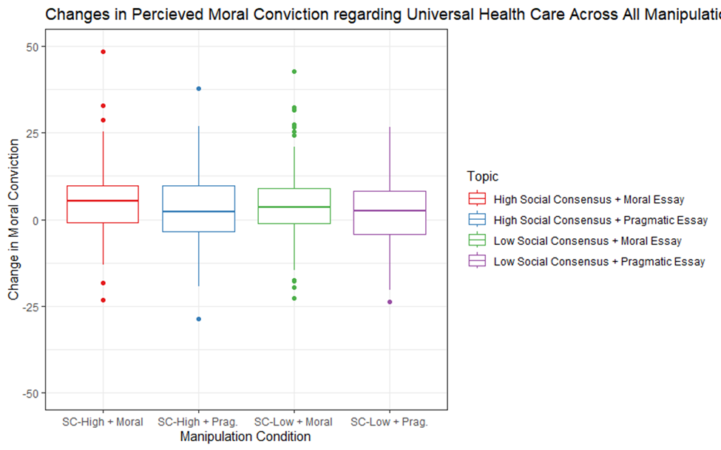

Slide 18
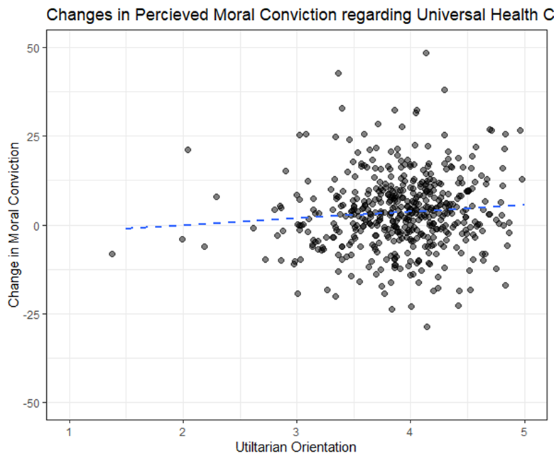

Slide 19
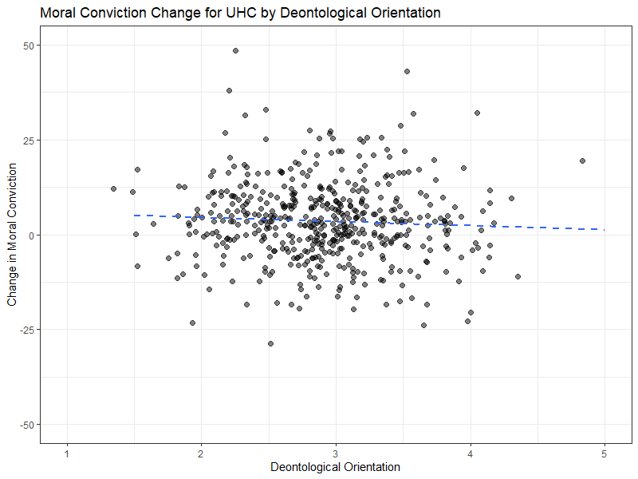

Slide 20
Capital Punishment
"Capital Punishment (The Death Penalty) is necessary in America"

Slide 21
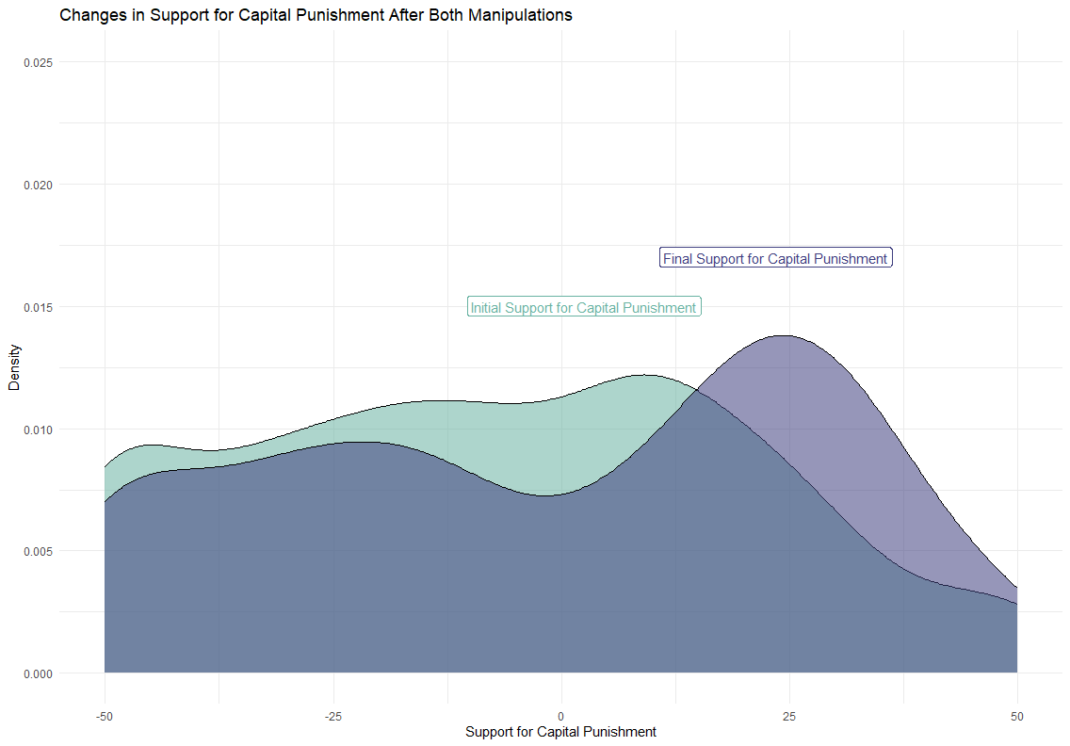

Slide 22
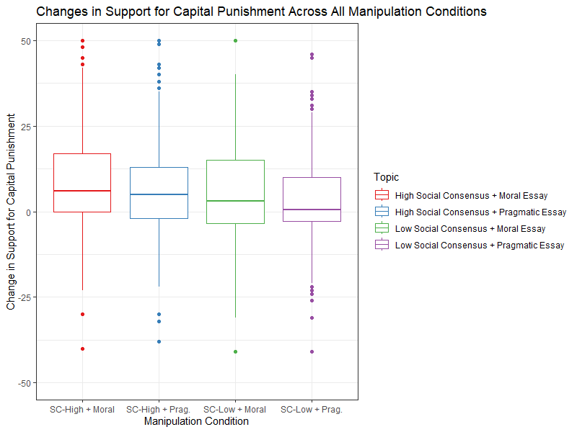

Slide 23
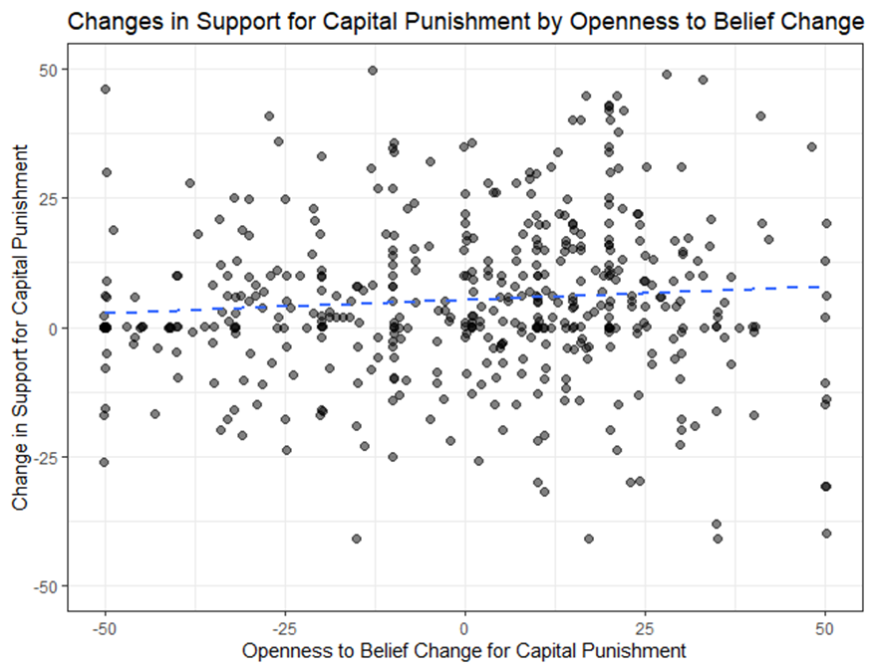

Slide 24
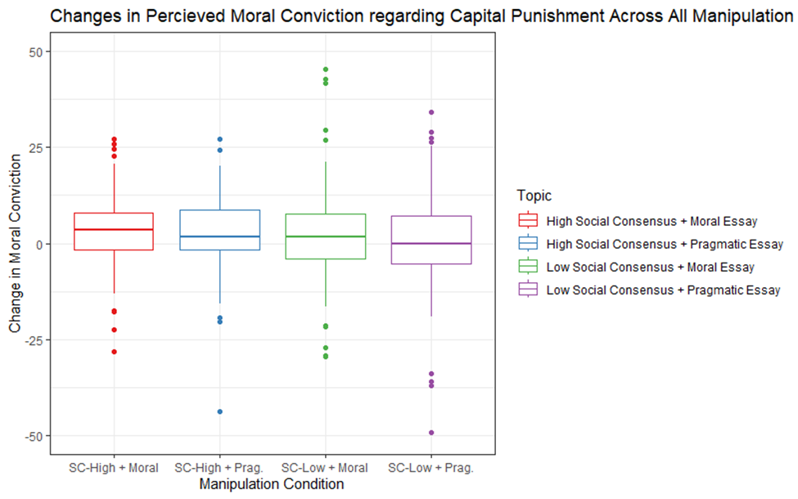

Slide 25
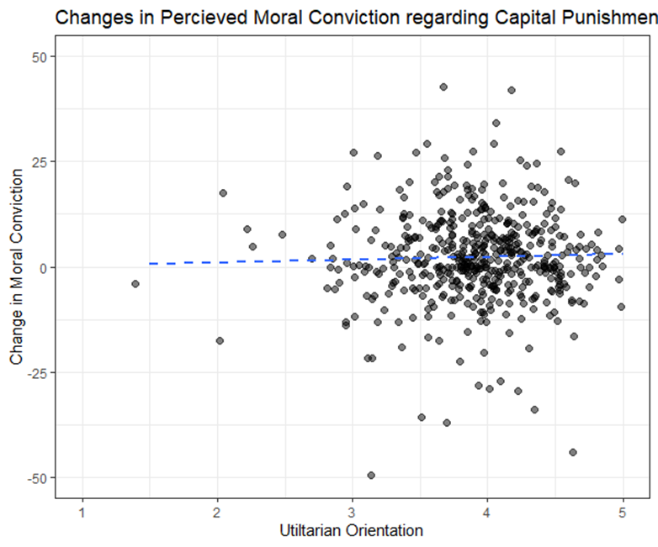

Slide 26
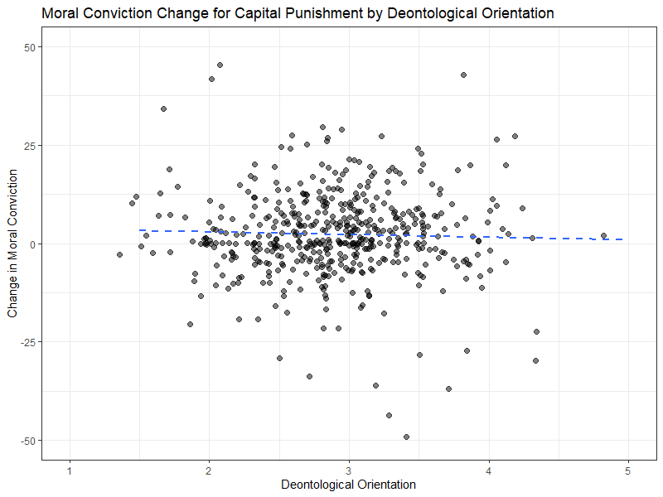

Slide 27
Usage of AI in the Workplace
"Americans should be able to use Artificial Intelligence (AI) for job applications"

Slide 28
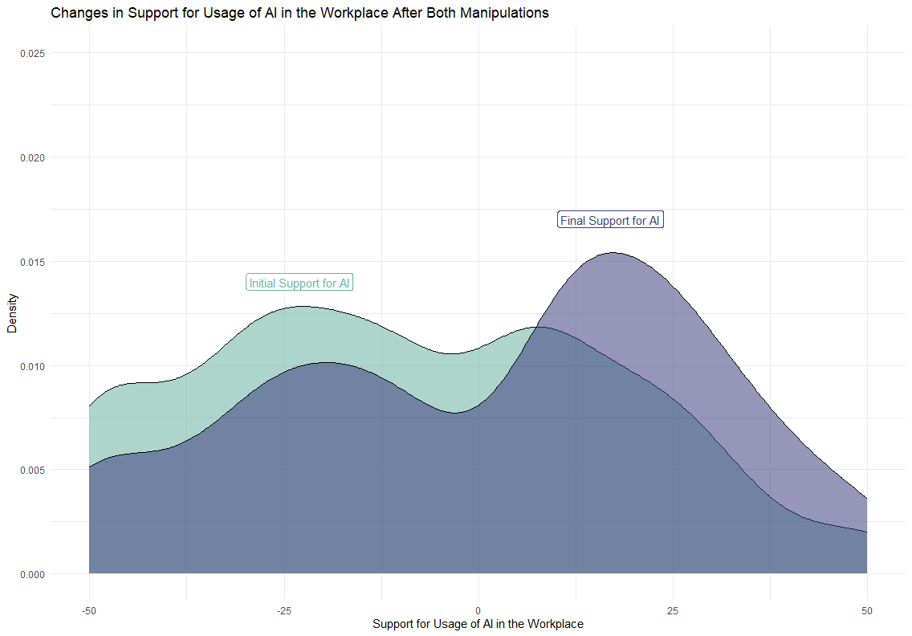

Slide 29
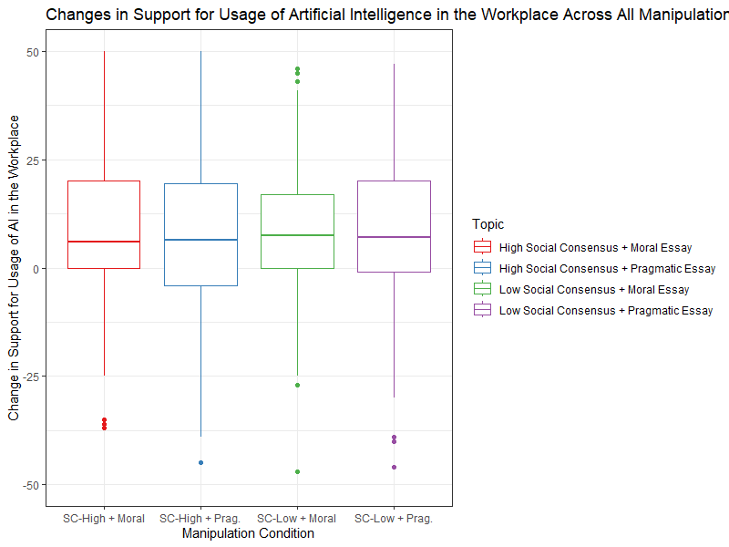

Slide 30
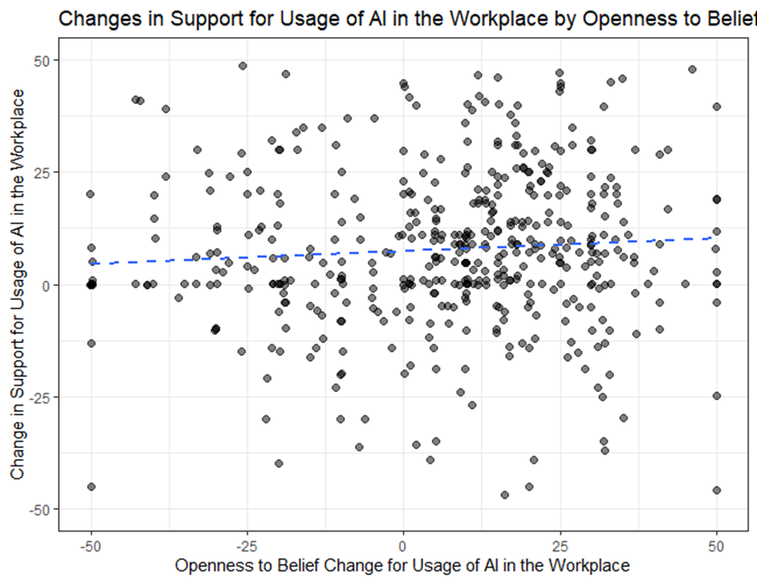

Slide 31
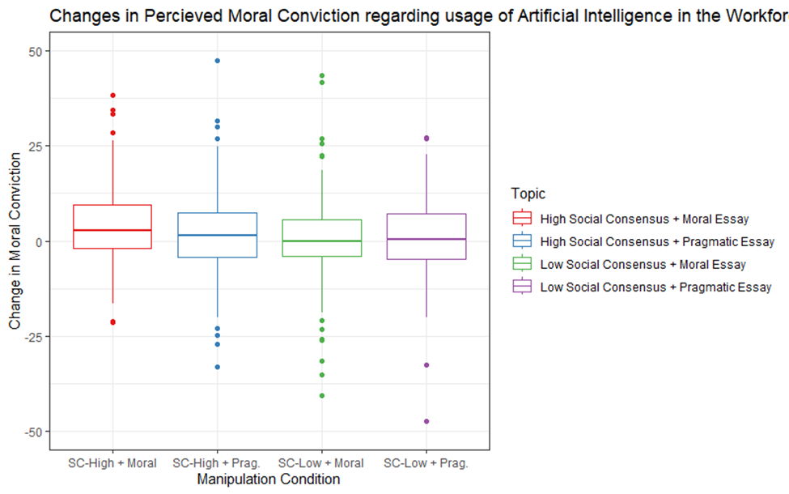

Slide 32
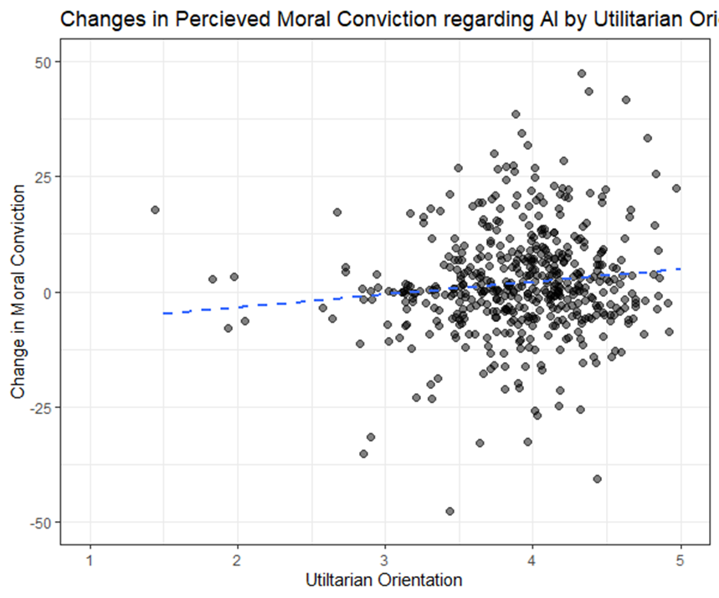

Slide 33
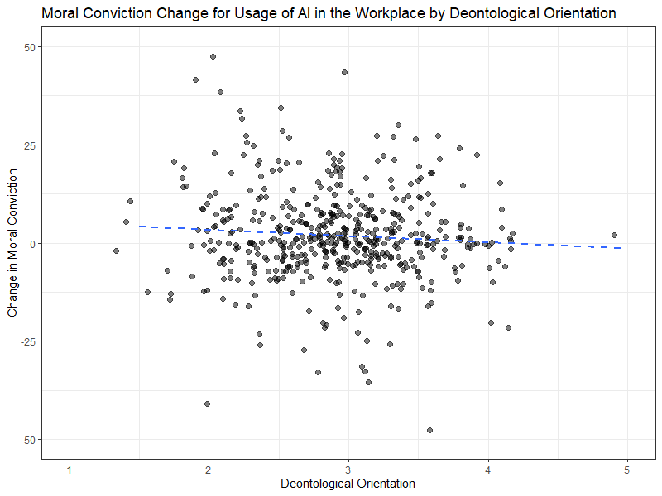

Slide 34
Preliminary Results
All our interventions did end up increasing support for all [Topics]
However… none of our interventions were differentiated on their increase of support
Notably – Low social consensus did NOT decrease support as in Study 1
Moral Conviction manipulation successful for UHC
Not so much for Capital Punishment or AI
Social consensus condition seemed to affect moral conviction for AI
Moral conviction was associated with deontological and utilitarian orientation, in opposite ways
Significant baseline differences in Topic Familiarity, Openness to Belief Change, and Initial Moral Conviction

